Slide 1
NAP5 – the Main Results and Incidences
Professor Jaideep J Pandit
Clinical Lead, NAP5

Slide 3
Methods
Broadly as for NAP3, NAP4
- All UK NHS hospitals
Service evaluation
I year registry anonymous
New for NAP5
- Inclusion of Ireland
- Negative reporting
Collaboration AAGBI + RCoA
Activity Survey

Slide 4
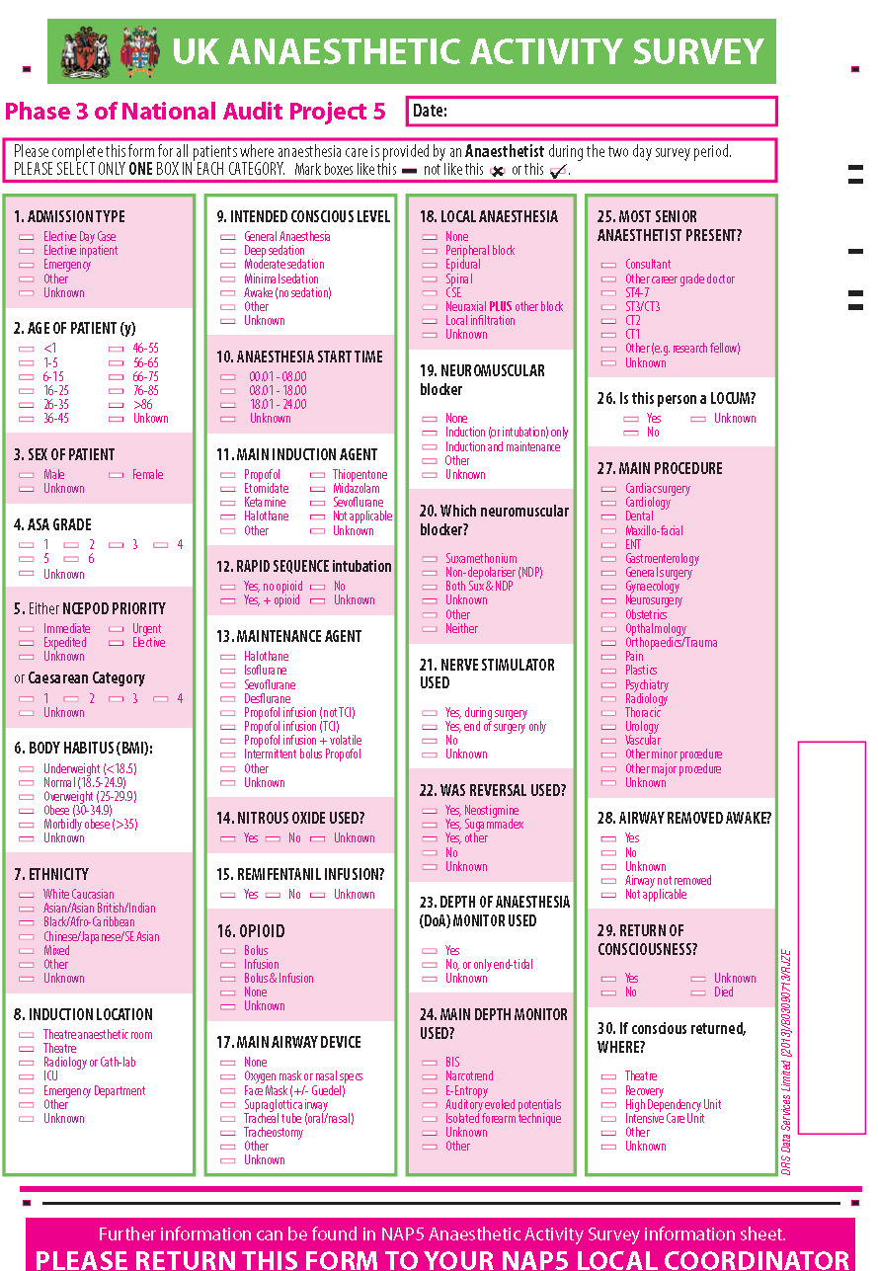
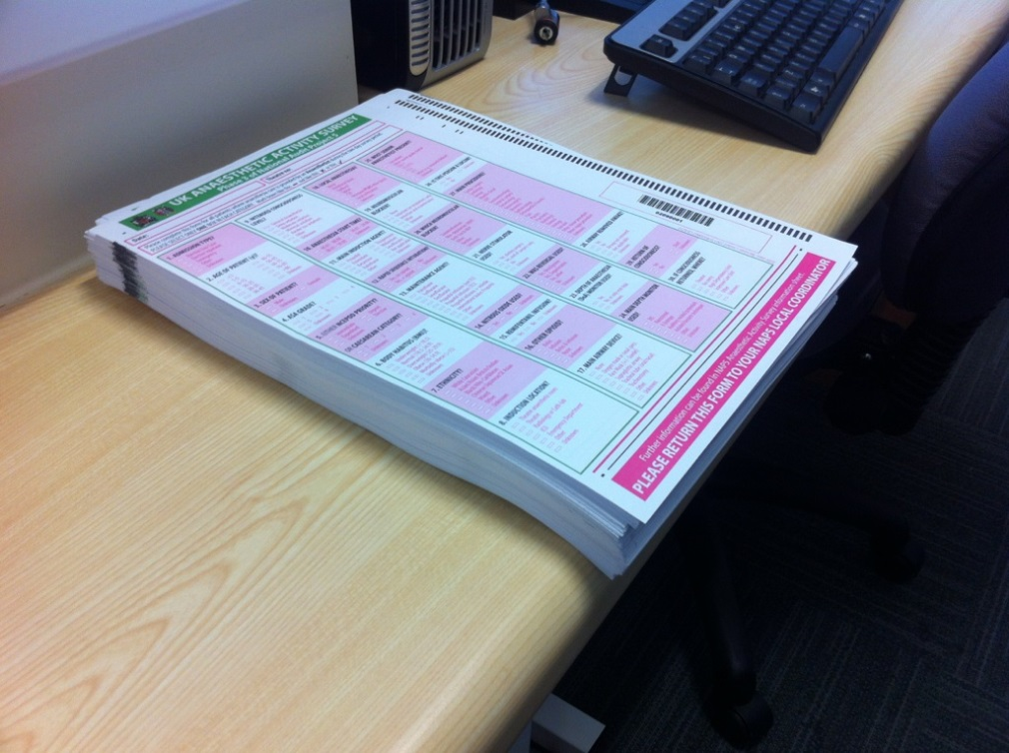
UK Activity survey

Slide 5
Inclusion criteria for AAGA
a new patient report
made between 1 June 2012 - 31 May 2013
that they had been aware for a period of time when they expected to be unconscious.

Slide 7
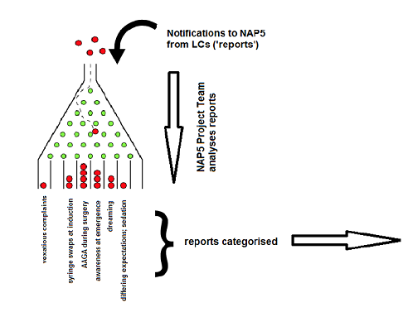

Slide 8
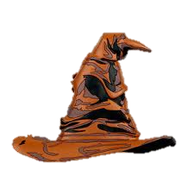

Slide 9
Cases reported
269 UK centres
108 filed zero returns over the year
161 (60%) centres had a report
471 requests to upload data
341 logins issued (130 inadmissible)
321 logins used (20 unused)
300 accepted (21 judged inadmissible)

Slide 11
Main focus is on certain/probable and possible reports
We can compare % Activity Survey vs AAGA s ‘relative risk’ or ‘hazard ratio’
In following graphs, proportions
Lines = Activity Survey
Bars = AAGA

Slide 12
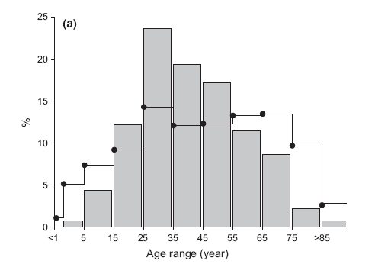
Age
AAGA most in young/middle age adults (viz. Baseline)

Slide 13
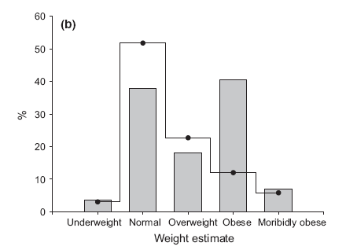
Weight
AAGA more in obese

Slide 14
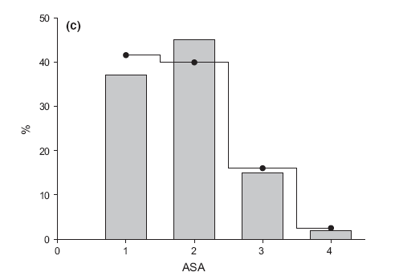
ASA
Not influential (ASA 3/ 4 more sensitive to drug; get less drug?)

Slide 15
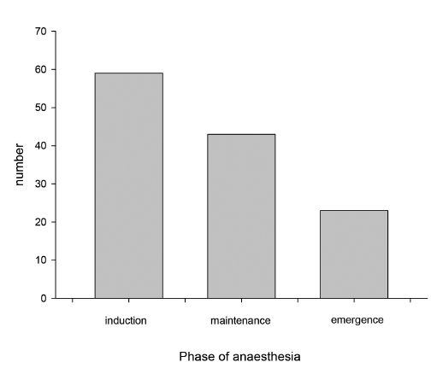
Phase of anaesthesia
Most common in dynamic phases

Slide 16
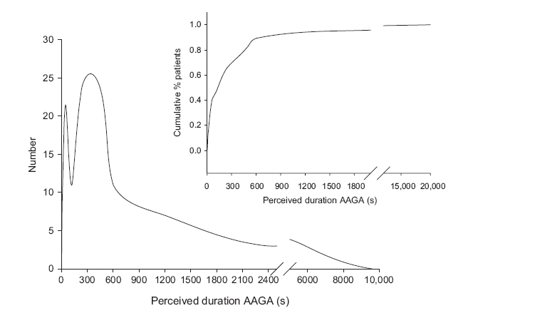
Duration AAGA very brief (median 3 mins)

Slide 17
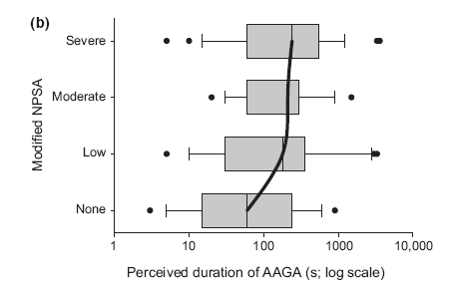
Duration per se did not affect impact-

Slide 18
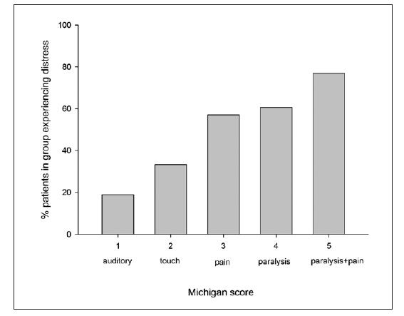
Distress caused especially by paralysis

Slide 19
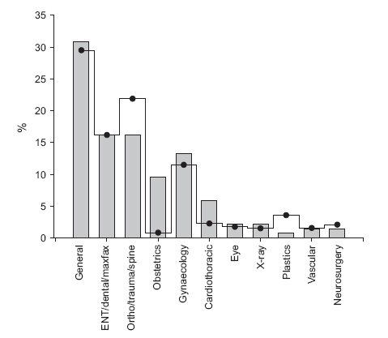
Types of surgery
OB and cardiothoracic over-represented…

Slide 20
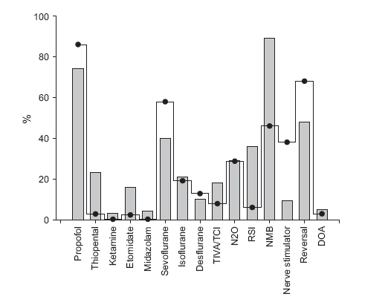
Modes of anaesthesia
Full profile

Slide 21
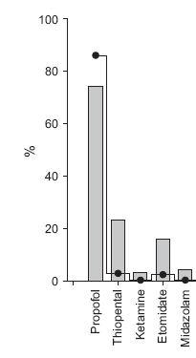
Induction
Thiopentone:
RSI/OB
3% of all inductions
87% if RSI inductions
Etomidate? RSI
(not used so much;
unfamiliarity?)

Slide 22
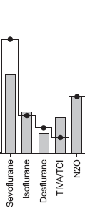
Maintenance
TIVA a risk?
N2O ‘neutral’
(less volatile used, so net
effect neutral?)
Sevo protective??
(agent-specific effects?)

Slide 23
NMB
The ‘unholy trinity’ that leads
to AAGA
- NMB
- no n stimulator
- no reversal

Slide 24
“Incidence”
Incidence of what?
AAGA highly heterogenous
Different methods look at different things
Brice = ~1:600
Baseline = ~1:15,000
NAP5 main study 1: 19,000 - aggregate

Slide 25
Incidence subgroups…
All patient reports, valid, substantiated or not (n = 471)
1: 6,000

Slide 26
Admissible patient reports (n = 300)
1: 12,000

Slide 27
Certain/probable or possible only (n = 141)
1: 20,000

Slide 28
When no NMB used
1 : 136,000
When NMB used
1: 8,200

Slide 29
Cardiothoracic
1 : 8,000 (same as NMB)
Caesarean section
1: 670 (close to Brice)

Slide 30
Paediatric
1: 61,000
AAGA reports after sedation by anaesthetists
1: 15,000
(AAGA more common after sedation than GA)

Slide 31
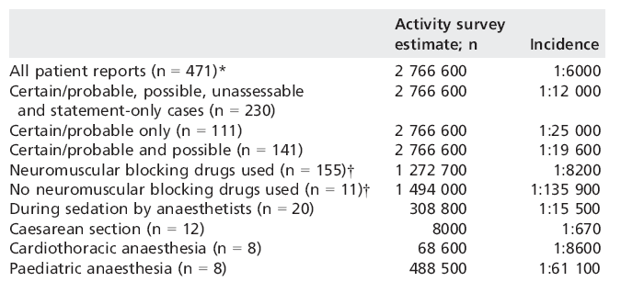

Slide 32
No single ‘incidence’
Brice differs from NAP5
NAP5 main study differs from Baseline
Within NAP5, differences in incidence between categories
Different methods look at different things
Different entities differ in degree to which detected by methods
These differences need researching

Slide 33
Interim Conclusions
AAGA risks (overview) appear to include:
Middle age
Obesity
Thiopentone as induction agent (etomidate)
RSI
OB and cardiothoracic
NMB, esp with no monitoring or reversal

Slide 34
Focus on
Phases of anaesthesia
TIVA/TCI
DOA

Slide 35
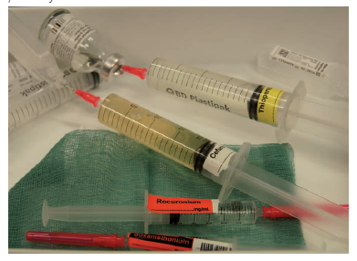
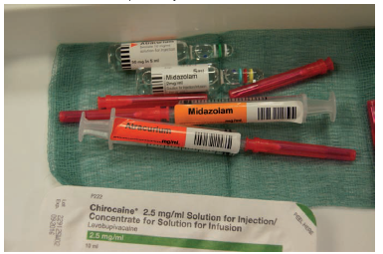
Induction/transfer
Syringe swaps

Slide 36
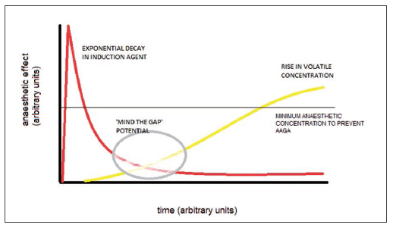
The ‘Gap’

Slide 37
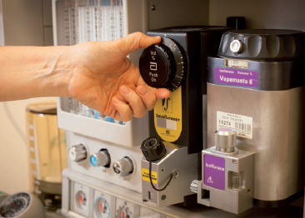
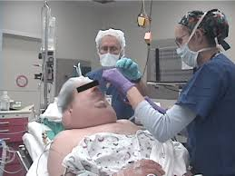
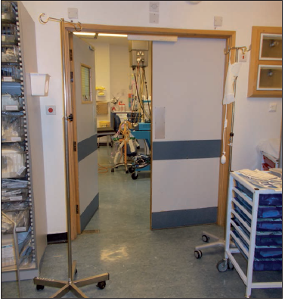
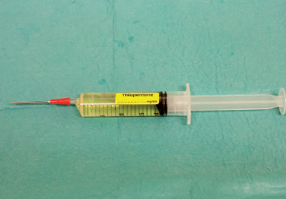
Causes of the gap
Prolonged intubation (thiopentone)
Redistribution (thiopentone)
Obesity
Anaesthetic room – theatre transfer delay
Omission of agent

Slide 38
Solution: checklist

Slide 39
Maintenance phase
36% of AAGA cases
40% at knife-skin; 8% right at end
Only ~50% during ‘stable’ phase
Causes
Similar to induction (gap)
Early cessation of rapid-offset agents
Inappropriately low agent concentrations (titrated to BP or BIS)

Slide 40
Maintenance phase
Highest % of ‘unknown’ cause (26%)
?genetic / innate resistance?
Phase in which ETAG alarms and/or DOA monitors might yield most benefit?

Slide 41
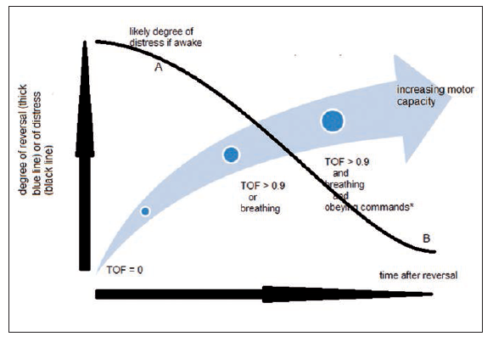
Emergence phase
18% of AAGA cases
Balance of GA vs NMB key feature

Slide 42
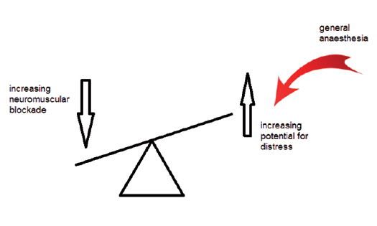
Patients are distressed by paralysis
Interpret it as AAGA
Anaesthesia enables coping with paralysis

Slide 43
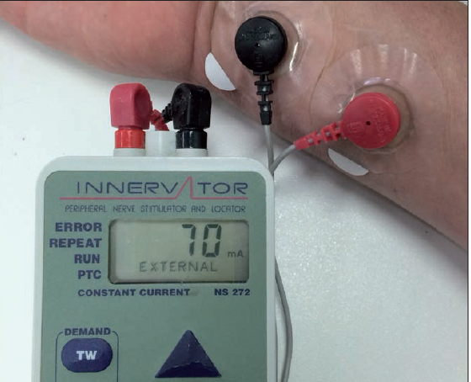
New approach to NMJ monitoring
Nerve stimulator = test of motor capacity
not to achieve deep NMJ blockade for surgery
More to confirm return of motor capacity at end

Slide 44
First, establish return of motor capacity
Then, reduce anaesthesia for wake up
‘awake extubation’ = extubation in patient with full motor capacity who is also awake
Not just a patient who is ‘awake’!
Implications for consent to warn about experience of awake extubation

Slide 45
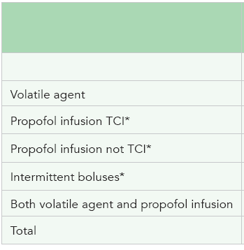
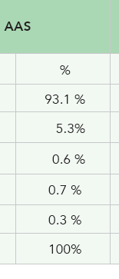
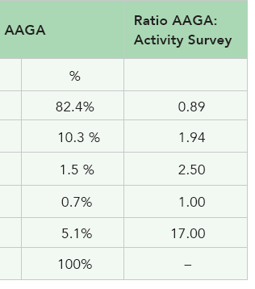
TIVA/TCI
Superficially a ‘risk’
However, non-standard / non-TCI methods most a risk, esp in ‘transfer’ scenarios

Slide 46
We recommend better training with TIVA/TCI
Special care with transfer of volatile to TIVA
Consider monitoring (DOA) in these cases

Slide 47
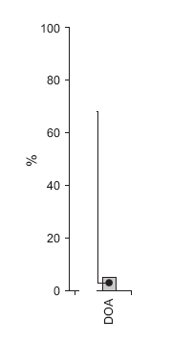
Headline figures: don’t tell whole story
DOAs in Activity Survey = 2.8%
DOAs in AAGA cohort = 4.3%
…over-representation in AAGAs ! (by ~50%)
Cannot be a ‘risk’ to use DOAs?
→ need to look at data more closely

Slide 48
Hazard ratios of anaesthetic techniques
TIVA + NBD presents most risk (3 -4 x)

Slide 49
Ratio of use of DOAs Activity Survey vs AAGA cases
Selective use in certain modes of anaesthesia
Greater use in TIVA+NBD – and greatest apparent benefit here too

Slide 50
Extra benefit of DOA?
Of the 6 AAGA cases with DOA only 1 was distressed
impact of AAGA milder with DOA use?
Trials focussing on TIVA + NMB and on impact on patients may show most benefit for DOAs

Slide 51
Caution with DOAs (1)
Titrating agent dosing to DOA output, even to very low agent levels
Elderly pt, cardiac surgery, BIS < 60 but ETAG titrated to 0.4 MAC to achieve this – AAGA with distress during positioning
Elderly pt, abdo surgery, BIS kept <55 but ETAG titrated to 0.4 MAC; AAGA with pain but no distress

Slide 52
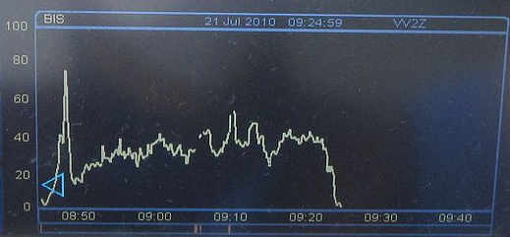
Caution (2)
If DOA used, and its output high, then this is compelling evidence that AAGA occurred, despite no other pointers
Pt made a complaint of AAGA after ortho surgery (with other complaints). Account vague but BIS briefly 65 after incision (~45 otherwise)

Slide 53
DOA Recommendations
We need to be familiar with existing DOAs
Including IFT
Need for pragmatic protocols for how to use and respond to DOA outputs, integrating with other information
DOAs likely most useful when NMBs used in highest risk categories (eg, TIVA)
Logically should be used from very start of/before induction END

Slide 54
Conclusions
NAP5 identifies high risk groups and situations
NMB, its impact and its monitoring is main message
Anaesthesia-specific checklist (WHO)
TIVA + NMB = care (+ DOA monitoring)
AAGA & incidences implications for consent
THANK YOU

